Slide 1

PYTHON WEB SCRAPING
NUGS-CHINA SkillUp Program

Slide 2
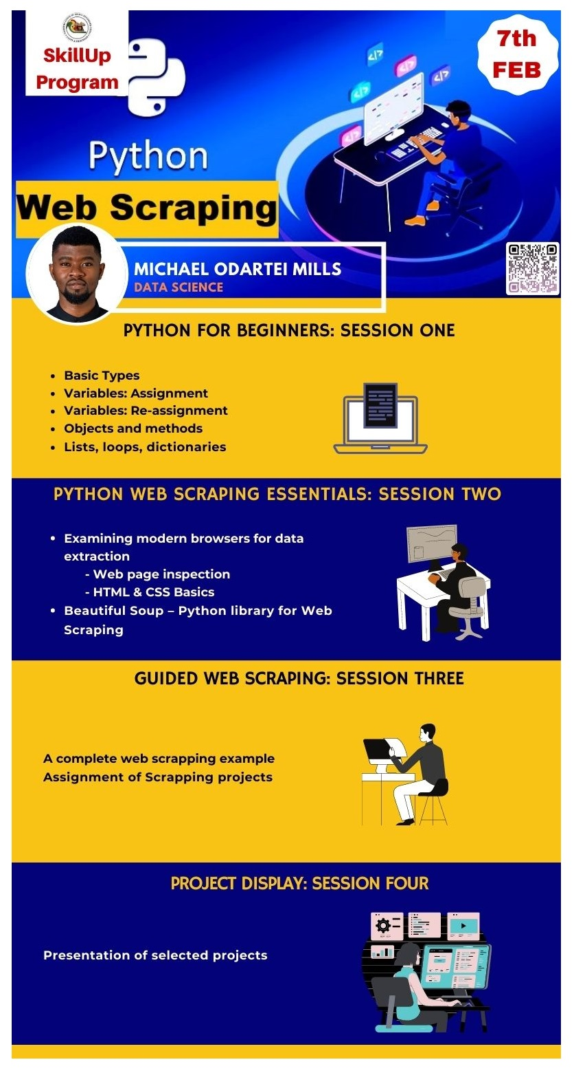

Slide 3
1. Python for Beginners
Open in your browser: bit.ly/nugspws

Slide 4


Today’s
Instructor
Michael
2019 Data Analytics with Python Trainee
Le Wagon, Chengdu M.Eng. Computer Science & Technology
University of Electronic Science & Technology of China, Chengdu
B.Sc. Computer Science
University of Cape Coast, Cape Coast

Slide 5
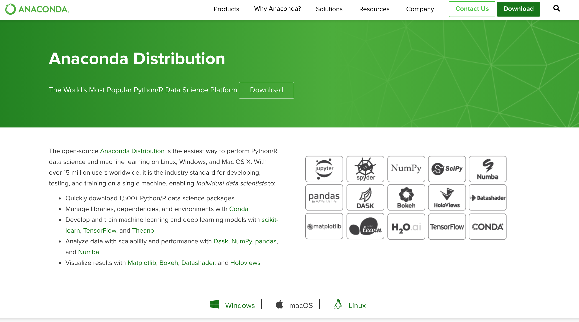
Today’s objectives
Get comfortable with Python tools
https://www.anaconda.com/distribution/

Slide 6
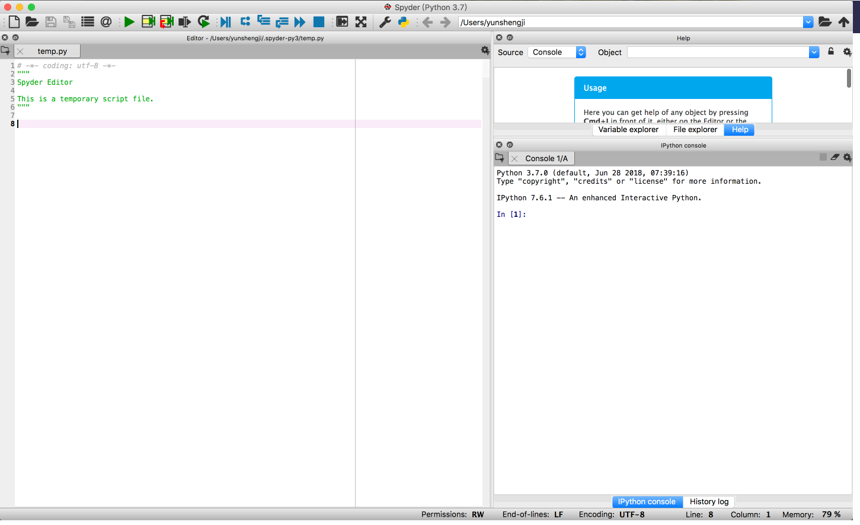
Today’s objectives
Learn and practice the basics of Python programming

Slide 7

Outline.
Python introduction (15 mins)
Basics of Python (45 mins)
Exercise (45 mins)

Slide 8
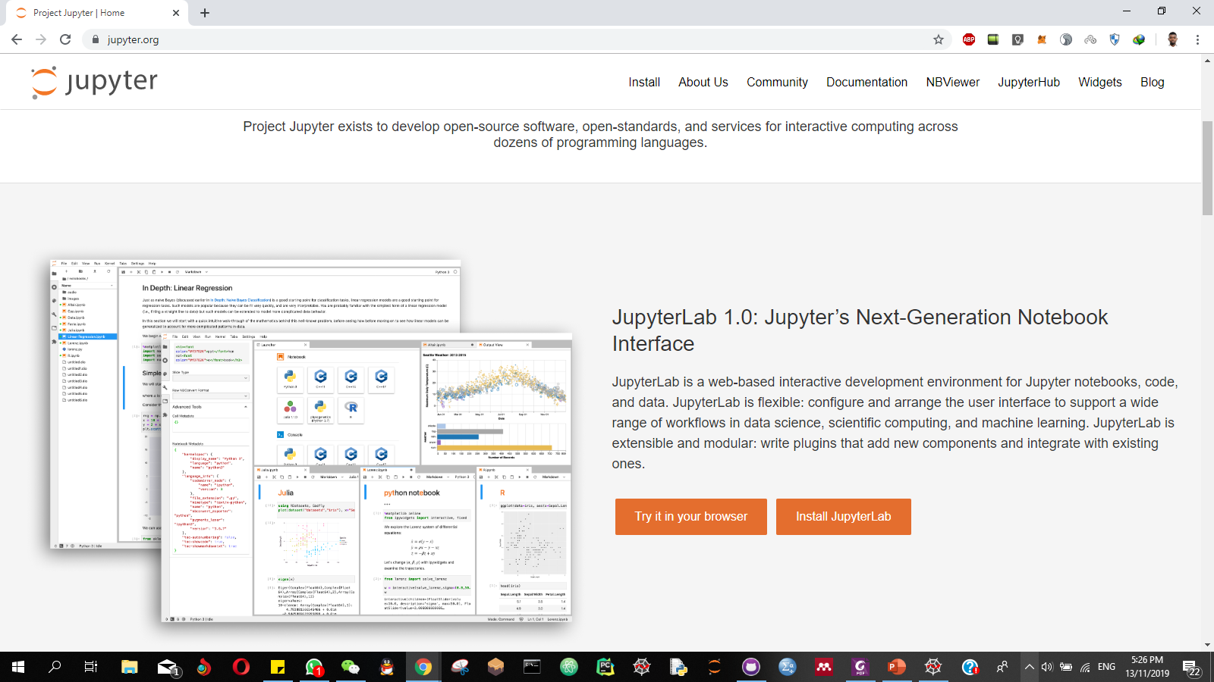
Your coding tool
Jupyter Notebook
Notes:
Jupyter.org

Slide 9
Introduction to Python
Python is a high-level programming language
What does this mean?
It’s multi-purpose(Web, Data Science, Scripting)
Open-source and community-driven, meaning…
Large standard library
Multi-platform
Interpreted
Garbage Collected
Created by Guido Van Rossum, first released in 1991
Notes:
Python is a high-level language, meaning that it abstracts underlying computer-related technical details. In addition, a high-level language can be expressed in a manner closer to English prose or mathematical equations.
Python is a general-purpose language meaning that it can be used for all problems that a computer is capable of rather than specializing in a specific area such as statistical analysis.
Python is an interpreted language meaning that evaluation of code to obtain results can happen immediately rather than having to go through a time-consuming, compile and run cycle, which thereby speeds up the thinking and experimentation processes.
Python has a standard library, and numerous third-party libraries yielding a vast array of existing codebases and examples for solving problems.

Slide 10
General Purpose
Web development (like: Django, Flask)
Scientific and Mathematical computing (Orange, Scipy, Numpy)
Desktop graphical user interfaces (Pygame, Panda3D)
Web crawler

Slide 11
Other features
Simple language which is easier to learn (than C, Java, JavaScript)
Extensible and embeddable
Expressiveness of language
Elegant syntax

Slide 12
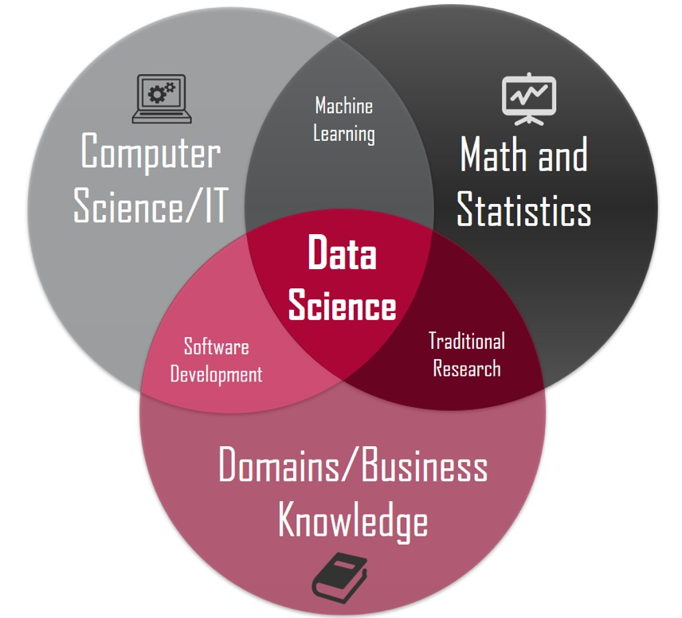
Why Python for Data?

Slide 13
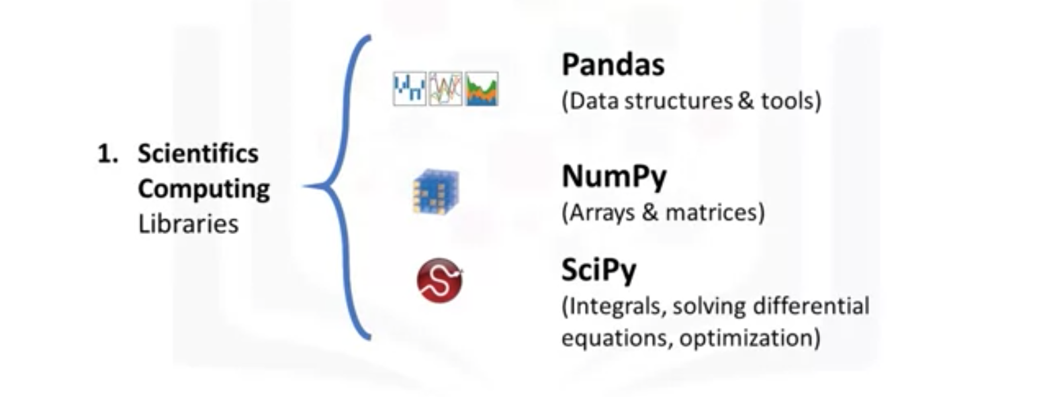
Scientifics Computing Libraries in Python
https://scipy.org/getting-started.html

Slide 14
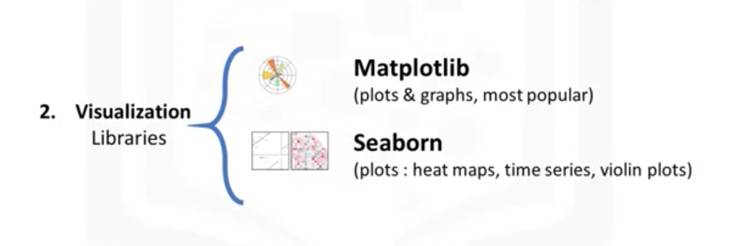
Visualization Libraries in Python
https://scipy.org/getting-started.html
https://seaborn.pydata.org/tutorial.html#tutorial

Slide 15
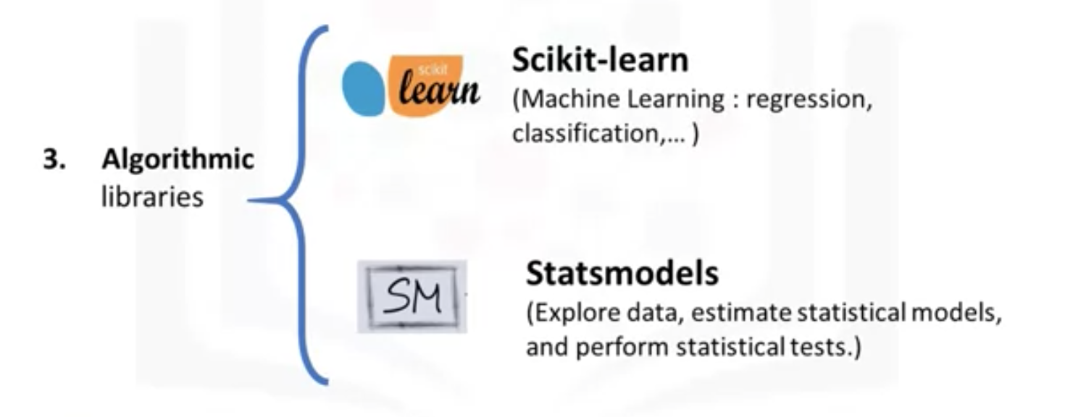
Algorithmic Libraries in Python
https://scikit-learn.org/stable/
https://www.statsmodels.org/stable/index.html

Slide 16
Python Basics

Slide 17
Head over to our Jupyter Notebook
http://bit.ly/nugspws
Notes:
https://www.programiz.com/python-programming/keyword-list

Slide 18
feedback.
Give me

